Slide 1
Next steps Filip Krasniqi, Jocelyne Elias and Jérémie Leguay
June 21, 2019

Slide 2
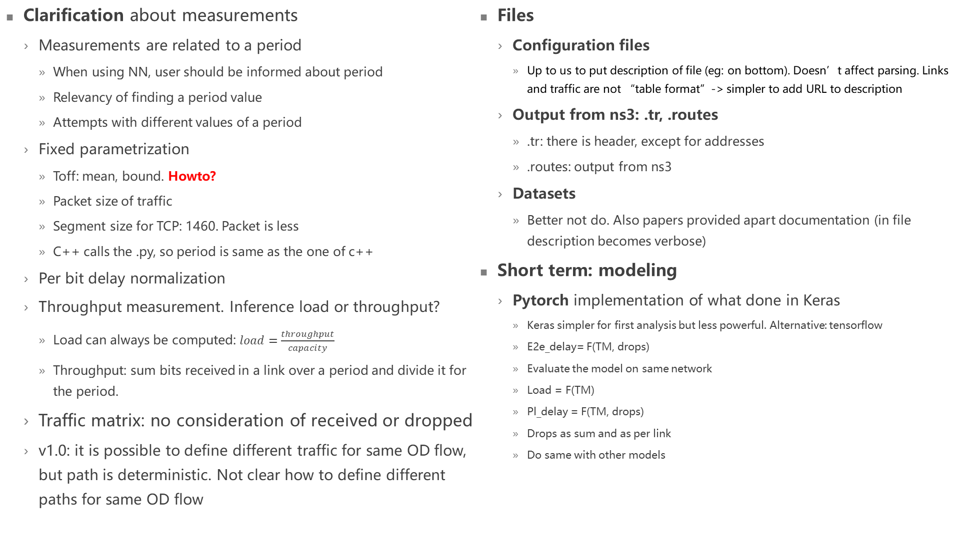
Clarifications, details on v1.0
Clarification about measurements
Measurements are related to a period
When using NN, user should be informed about period
Relevancy of finding a period value
Attempts with different values of a period
Fixed parametrization
Toff: mean, bound. Howto?
Packet size of traffic
Segment size for TCP: 1460. Packet is less
C++ calls the .py, so period is same as the one of c++
Per bit delay normalization
Throughput measurement. Inference load or throughput?
Load can always be computed: $load=\frac{throughput}{capacity}$
Throughput: sum bits received in a link over a period and divide it for the period.
Traffic matrix: no consideration of received or dropped
v1.0: it is possible to define different traffic for same OD flow, but path is deterministic. Not clear how to define different paths for same OD flow
Files
Configuration files
Up to us to put description of file (eg: on bottom). Doesn’t affect parsing. Links and traffic are not “table format”-> simpler to add URL to description
Output from ns3: .tr, .routes
.tr: there is header, except for addresses
.routes: output from ns3
Datasets
Better not do. Also papers provided apart documentation (in file description becomes verbose)
Short term: modeling
Pytorch implementation of what done in Keras
Keras simpler for first analysis but less powerful. Alternative: tensorflow
E2e_delay= F(TM, drops)
Evaluate the model on same network
Load = F(TM)
Pl_delay = F(TM, drops)
Drops as sum and as per link
Do same with other models

